Slide 1
Age AND SEX (M/F)
2021 Census: Second Data Release, April 27, 2022
Presentation to the Board, June 22 2022
Dave Plumstead; Manager of Planning, Outcomes & Analytics

Slide 2
data Release schedule
2022 | Topic
February 9 | Population and dwelling counts
April 27 | Age and Sex Type of dwelling
July 13 | Families, households, marital status, Income
August 17 | Language
September 21 | Indigenous peoples Housing
October 26 | Immigration, Place of birth, Ethnoculture, religion, Mobility, migration
November 30 | Education Labour force
March 23 presentation
Today's presentation

Slide 3
RECAP FROM LAST PRESENTATION
There are many levels of geography for census data dissemination
A Census Division (CD) is a group of neighbouring municipalities joined together for the purposes of regional planning and managing common services (e.g. Nipissing District).
A Census Sub Division (CSD) is the general term for municipalities (as determined by provincial/territorial legislation) or areas treated as municipal equivalents for statistical purposes – we have 15 CSDs in Nipissing District.

Slide 4
A note on Age:
There is a lot of statistical work we can do with simple age data! For example, we can look at single year age distribution; age groups; age structure; change/ trends; summary measures (average/ median age); etc.
We can also look at the age data for various levels of geography, and cross reference it with other census data (e.g., family households, housing, income, etc.)
For this short presentation we will start by looking at the age structure for Ontario and Nipissing District and the general age groups for Nipissing municipalities and areas

Slide 5
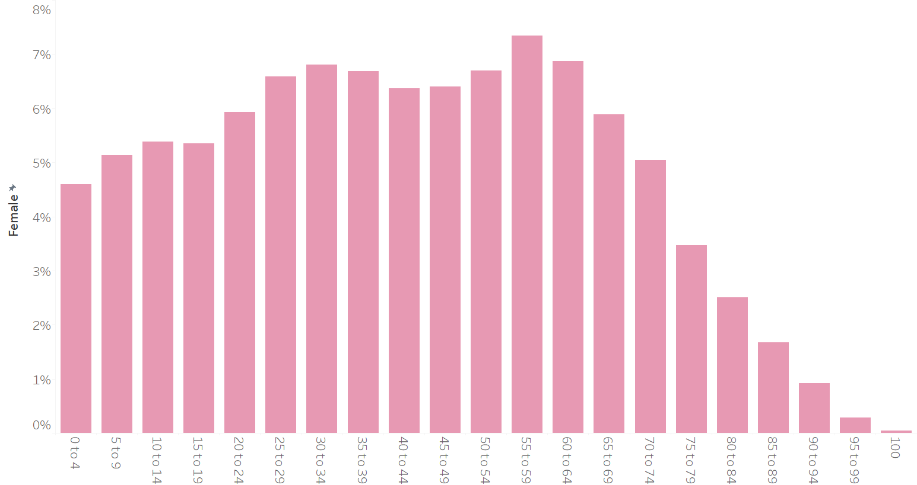
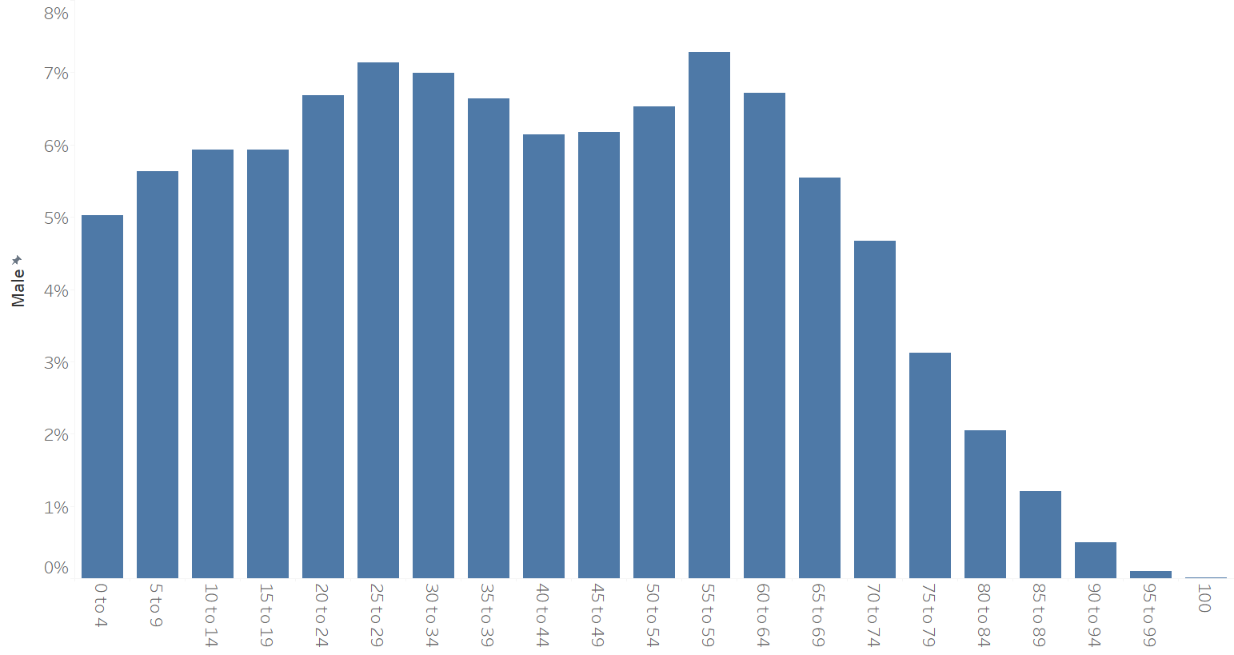
Ontario Age Distribution
Female age distribution: 5-year age groups, 0 to 100+
Male age distribution: 5-year age groups, 0 to 100+

Slide 6
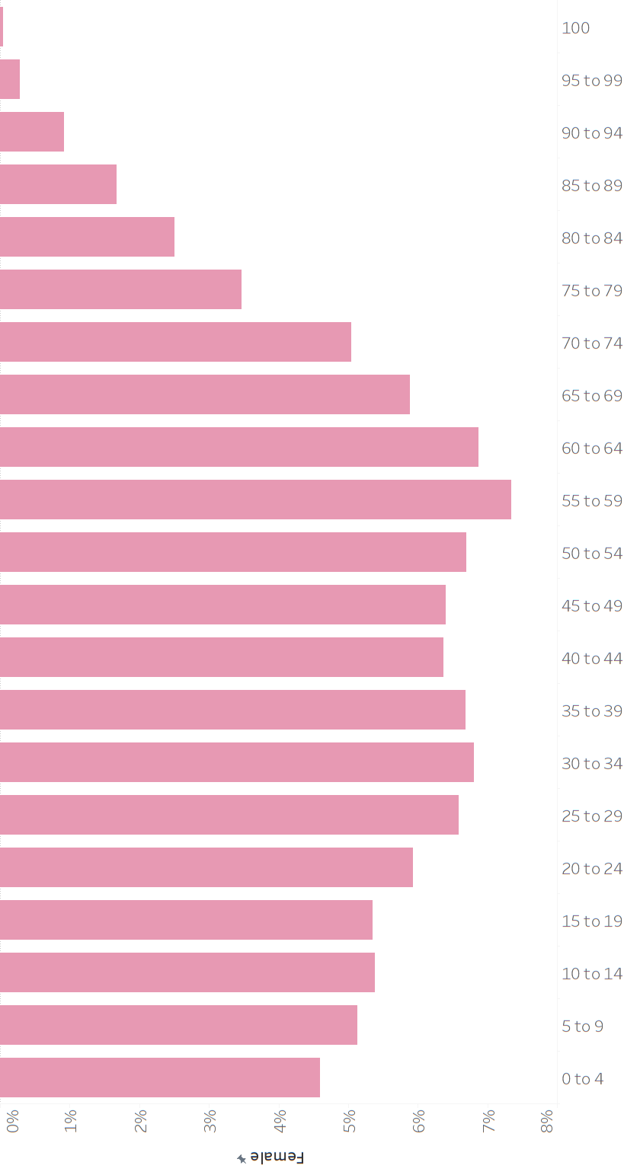
Population Pyramid

Slide 7
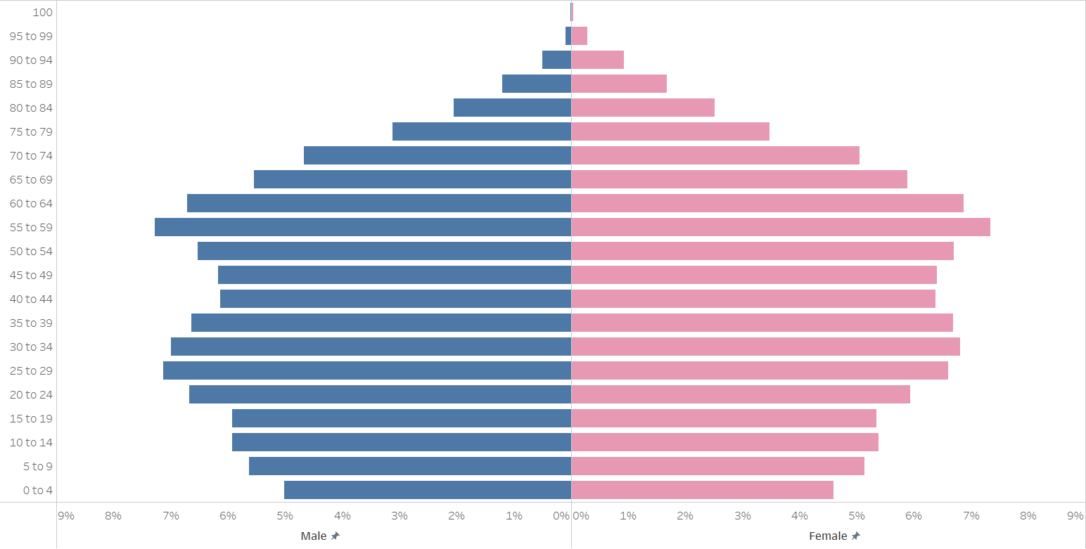
Ontario Age Structure, 2021
18.5%
Senior citizens
(age 65+)
24.0%
Boomers
(age 56-75)
53.5%
Core working
Group (25-64)
28.0%
Children & Youth (0-24)

Slide 8
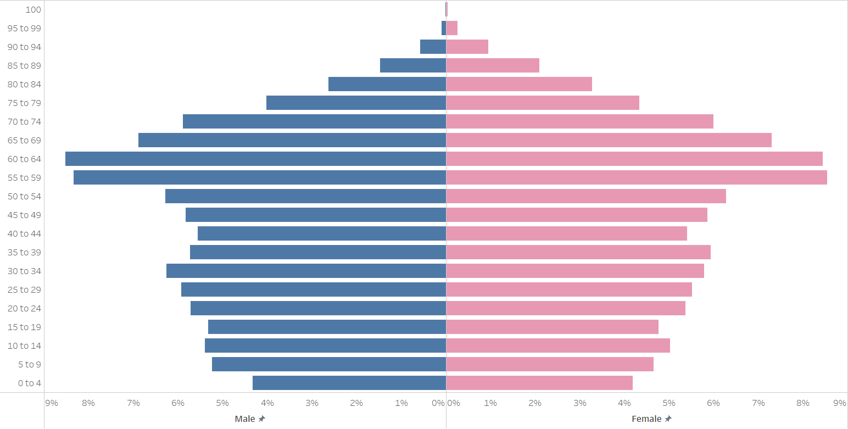
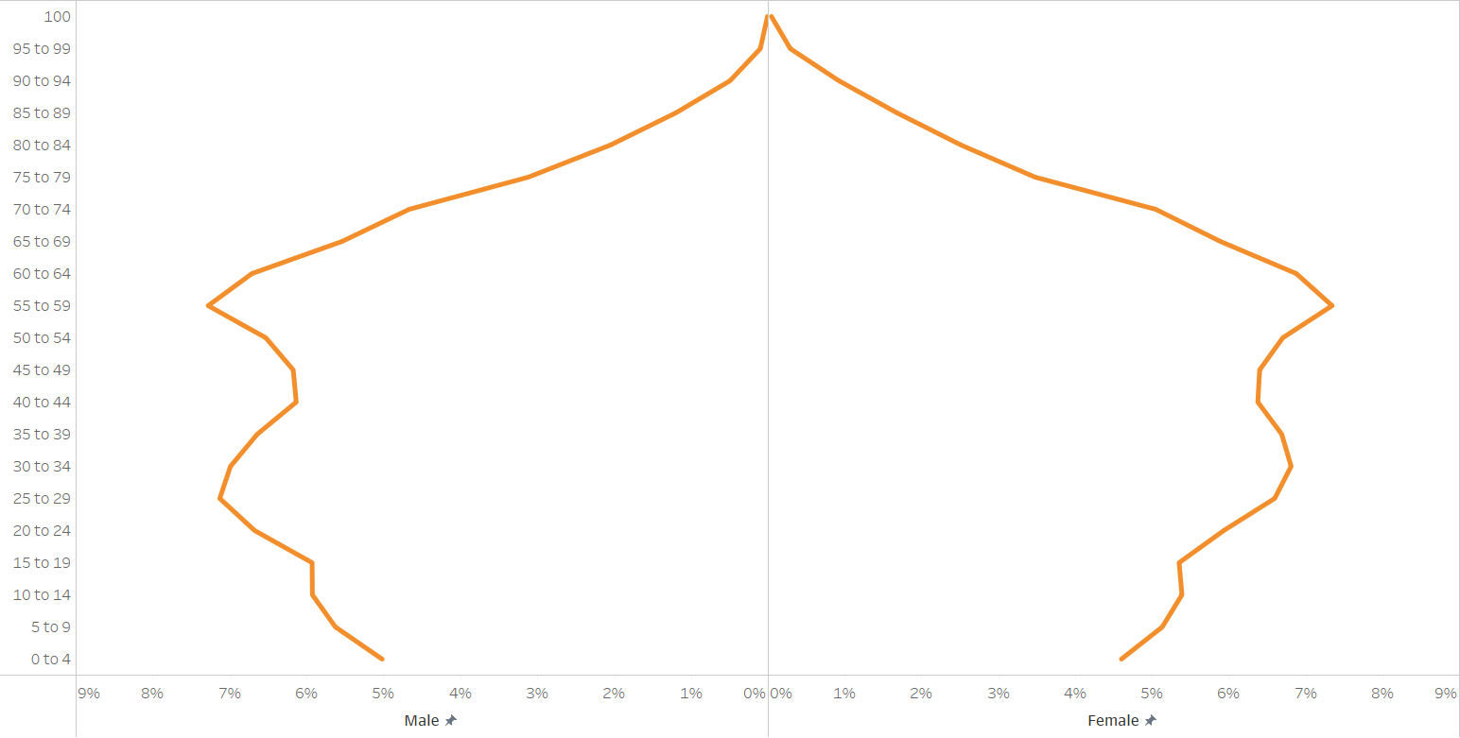

Nipissing District Age Structure, 2021
23.0%
Senior citizens
(age 65+)
29.5%
Boomers
(age 56-75)
52.0%
Core working
Group (25-64)
25.0%
Children & Youth (0-24)

Slide 9
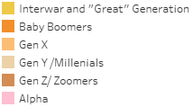
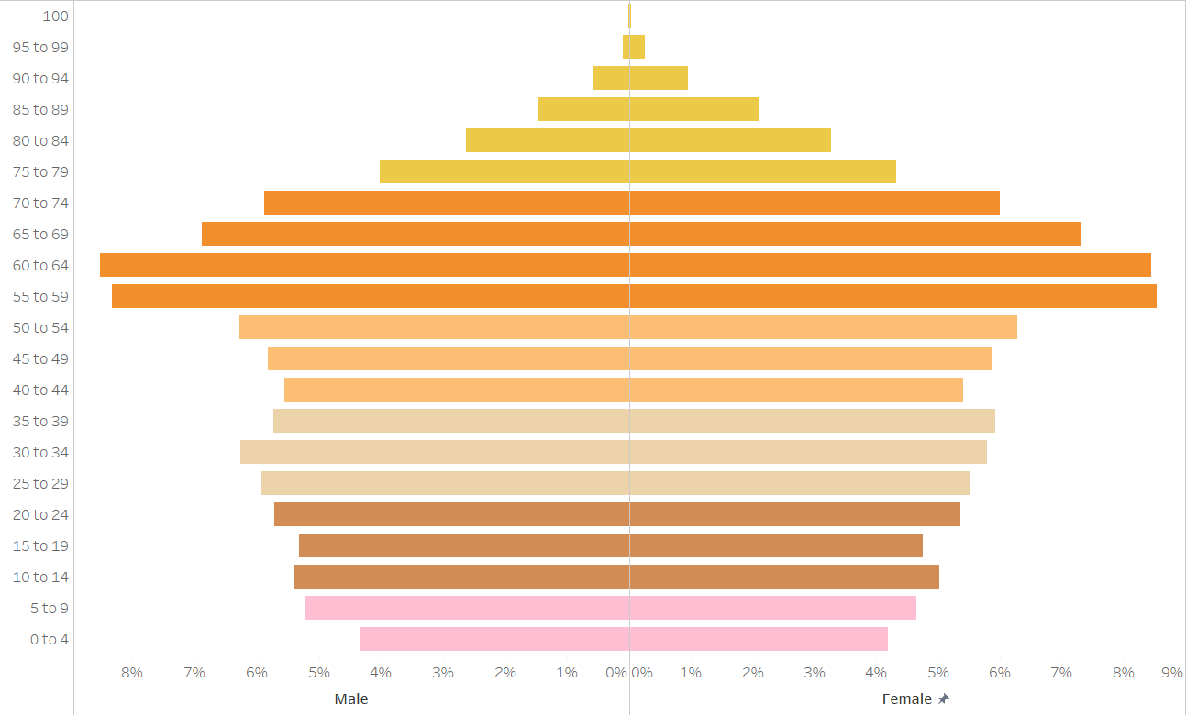
Nipissing District Generations

Slide 10
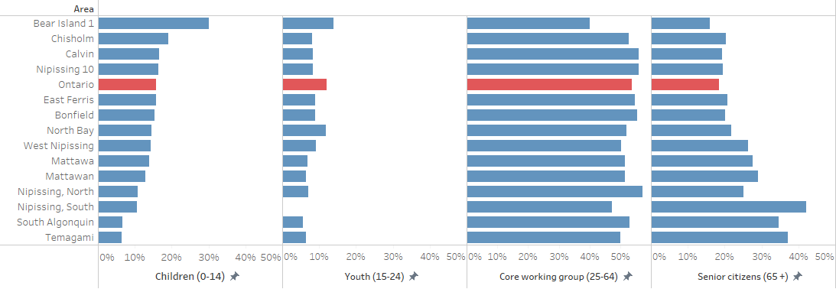
General Age Groups: Nipissing Municipalities and Areas
15.8%
11.9%
53.7%
18.5%
So we also see some significant age variation and older population structures within the district. For example, South Algonquin and Temagami (furthest rural areas) vs. the eastern municipalities
Implications: planning; public service delivery; consumption of goods & services; workforce; etc.

Slide 11


Thank you!

