Slide 1
Population and Dwelling Growth
2021 Census: First Data Release, Feb. 9, 2022
Presentation to the Board, March 23 2022
Dave Plumstead; Manager of Planning, Outcomes & Analytics

Slide 2
data Release schedule
2022 | Topic
February 9 | Population and dwelling counts
April 27 | Age and sex Type of dwelling
July 13 | Families, households, marital status, Income
August 17 | Language
September 21 | Indigenous peoples Housing
October 26 | Immigration, Place of birth, Ethnoculture, religion, Mobility, migration
November 30 | Education Labour force
And multiple subtopics

Slide 3
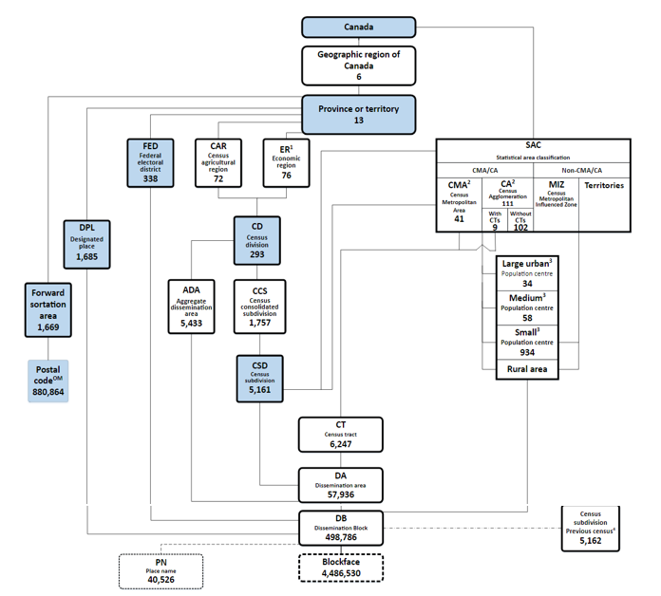
geography Levels 2021
There are many levels of geography for census data dissemination:
Notes:
.

Slide 4
Census Divisions 2021
Census division (CD) is the general term for provincially legislated areas or their equivalents
A CD is a group of neighbouring municipalities joined together for the purposes of regional planning and managing common services
12 CD classifications in Canada – we have six classifications in Ontario and 49 CDs:
ABBR. | Census Division Types in Ontario | #
CDR | Census division / Division de recensement | 9
CTY | Counties | 20
DIS | District | 10
DM | District Municipality | 1
RM | Regional Municipality | 6
UC | United Counties | 3
Total |  | 49

Slide 5
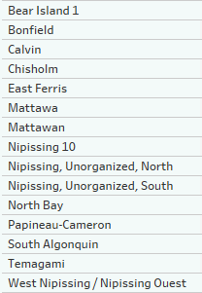
Census SubDivisions 2021
Census sub division (CSD) is the general term for municipalities (as determined by provincial/territorial legislation) or areas treated as municipal equivalents for statistical purposes
In Nipissing District, we have 15 CSDs:

Slide 6
A note on Census Dwellings:
Dwellings
Private dwellings
Regular private dwellings
Occupied marginal dwellings
Collective dwellings
Occupied dwellings (by usual residents)
Occupied dwellings (by foreign residents or temp. persons)
Unoccupied dwellings
This presentation includes the dwelling counts for occupied dwellings by usual residents

Slide 7
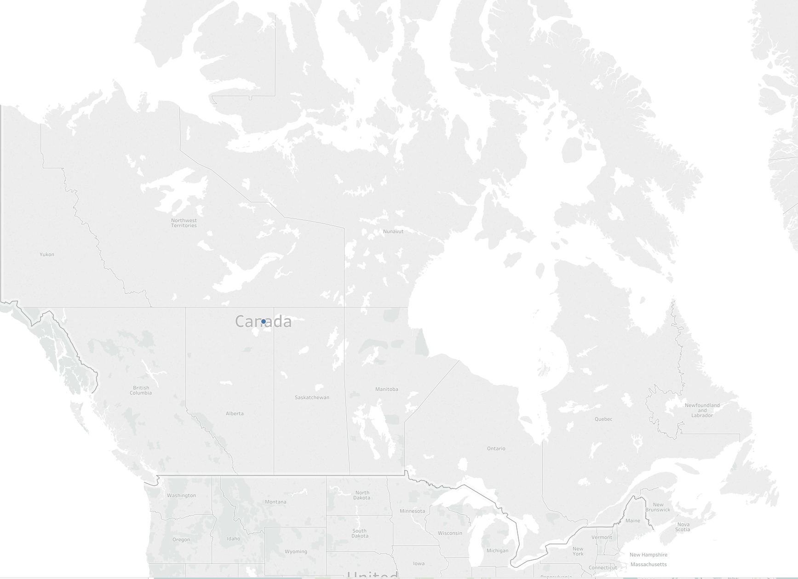
Canada Population & Dwellings 2021
5.2%
Population: 36,991,981
6.4%
*Private Dwellings: 14,978,941
*Occupied by usual residents

Slide 8
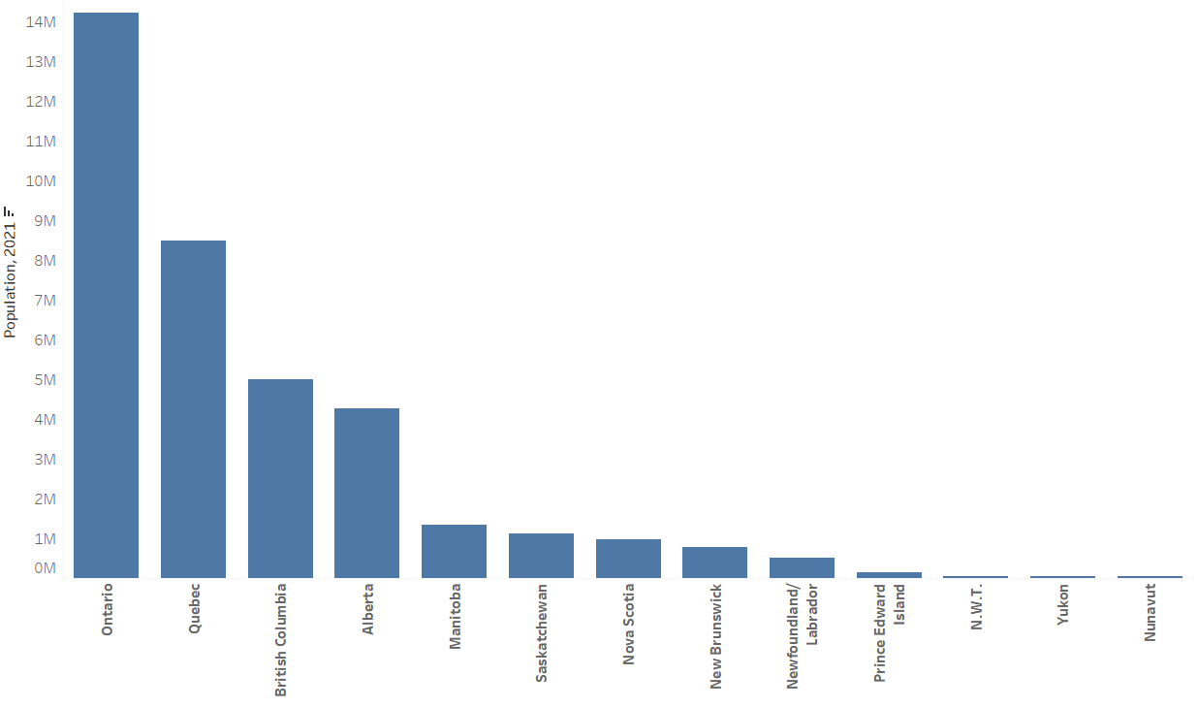
Province & Territories Population 2021
38.5%
23%
25%

Slide 9
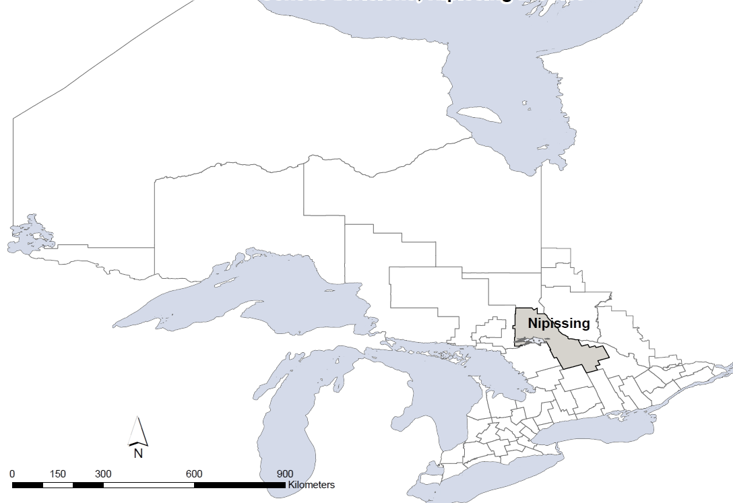
Ontario Population & Dwellings 2021
5.8 %
Population: 14,223,942
6.2%
*Private Dwellings: 5,491,201
*Occupied by usual residents

Slide 10
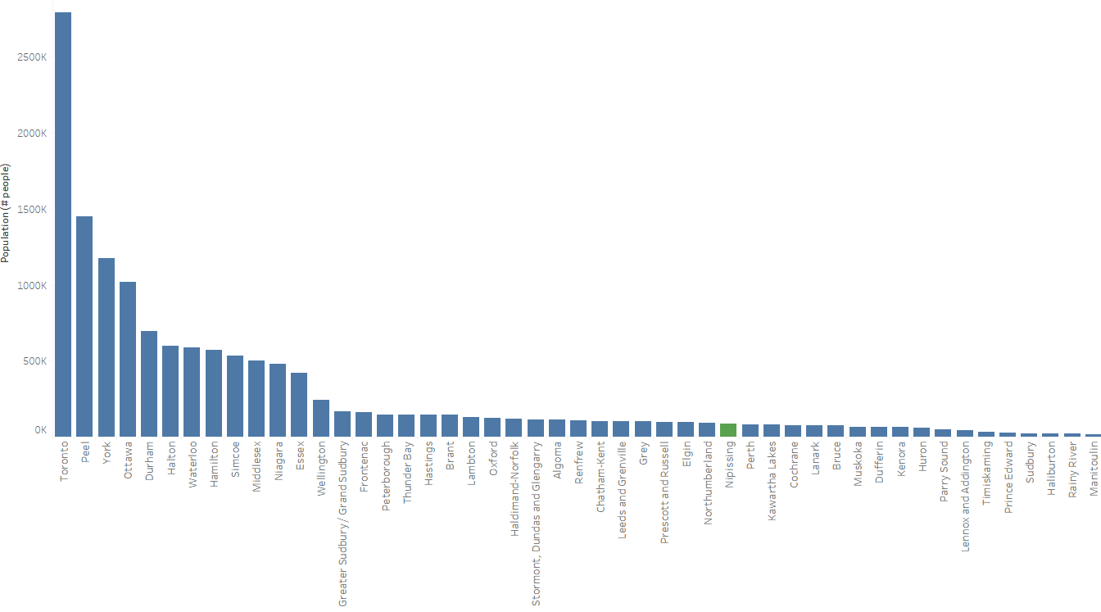
Ontario’s 49 CDs Population 2021
19.5 %
25.5%
31%

Slide 11

Ontario’s 49 CDs Population 2021
19.5 %
25.5%
31%
Northern Ontario: 5.5%

Slide 12
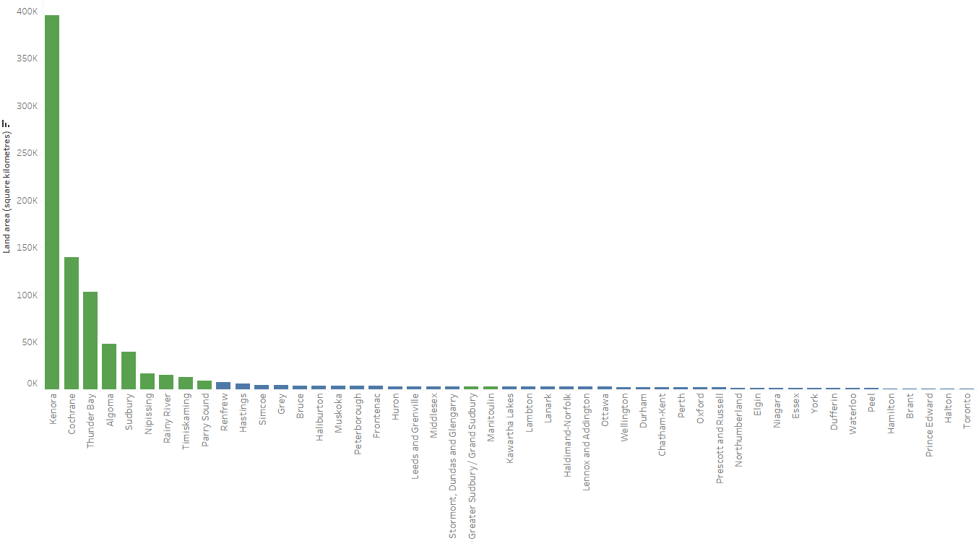
Ontario’s 49 CDs Land Area 2021
88%

Slide 13
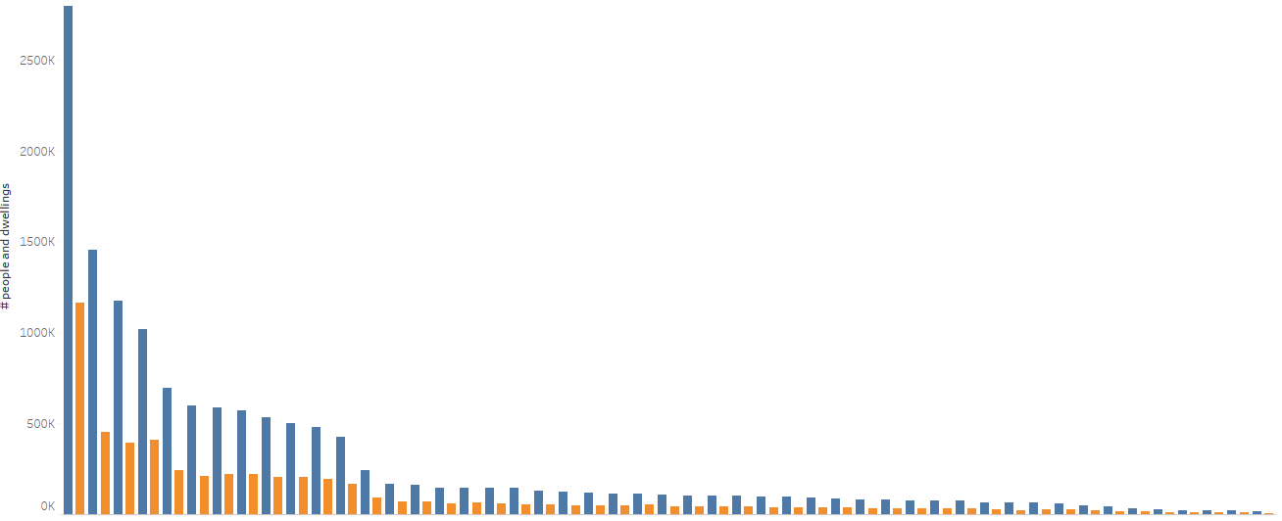

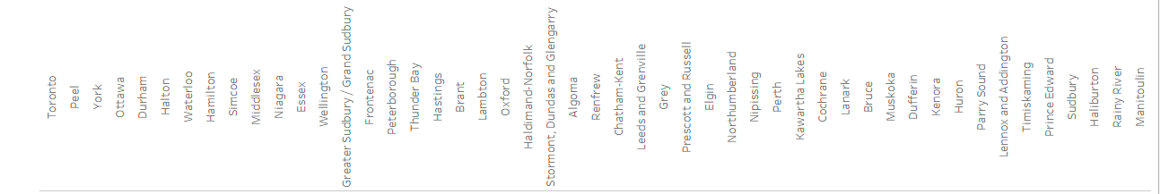
Ontario 49 CDs Population & Dwellings 2021
The distribution of dwellings closely follows population in most cases

Slide 14
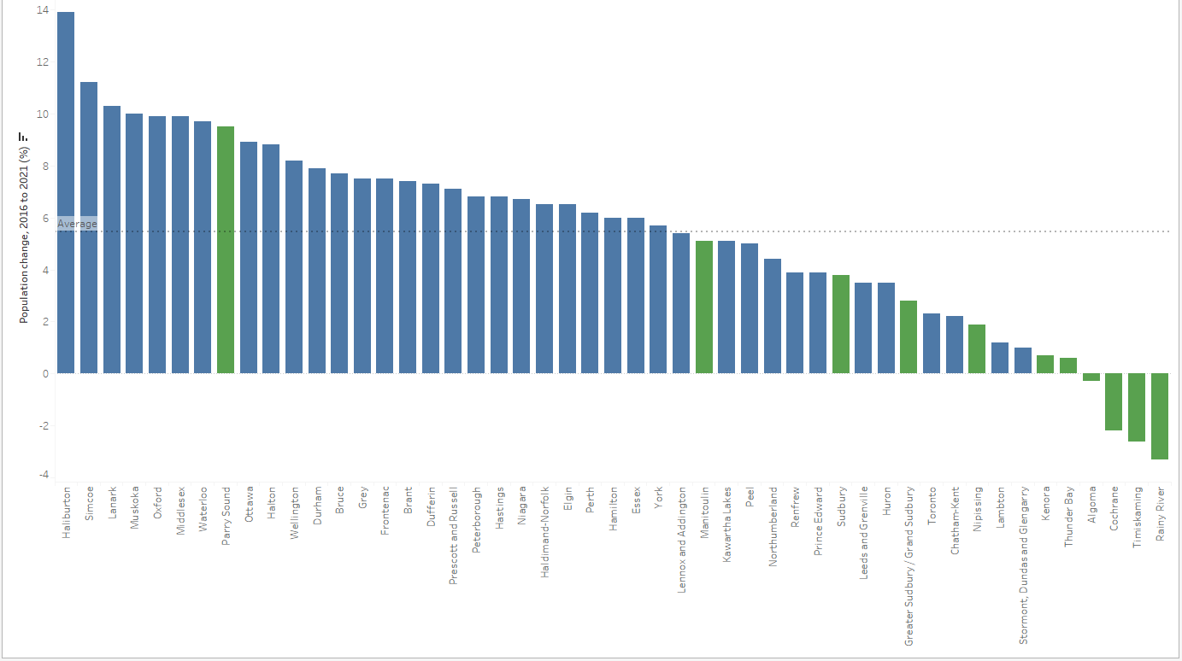
Ontario’s 49 CD Population Change 2016-2021

Slide 15
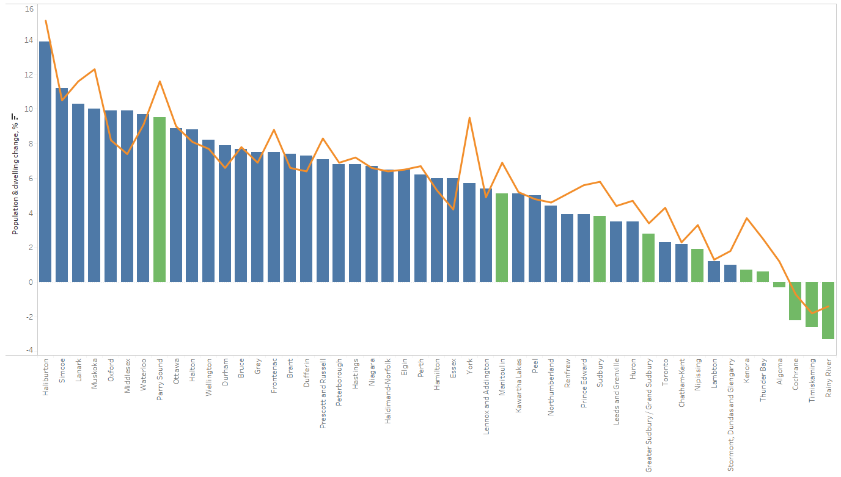

Ontario’s 49 CD Pop. & Dwell. Change 2016-2021

Slide 16
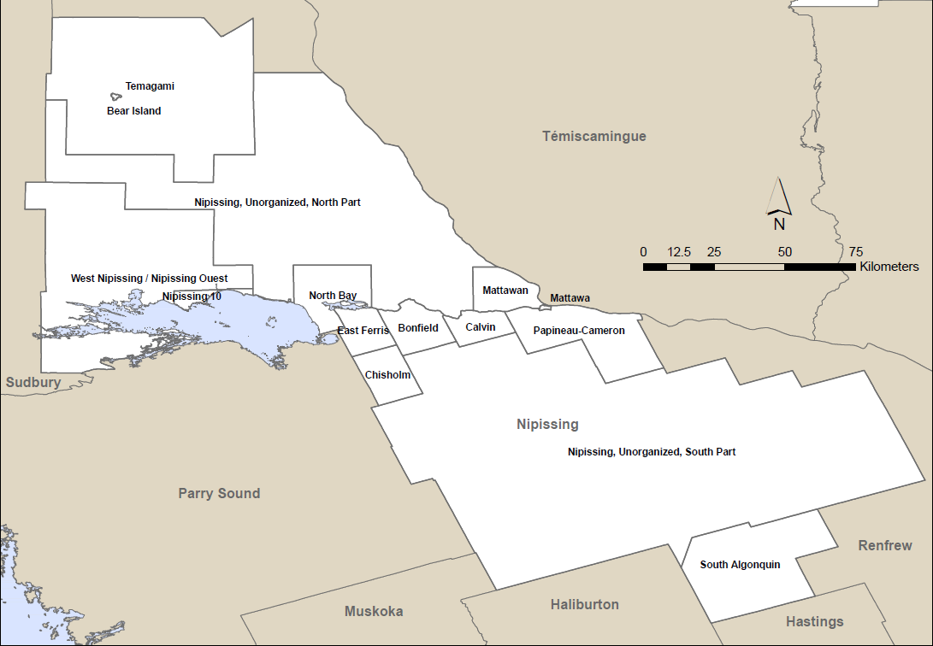
Nipissing District Population & Dwellings 2021
1.9%
Population: 84,716
3.3 %
*Private Dwellings: 37,252
*Occupied by usual residents

Slide 17
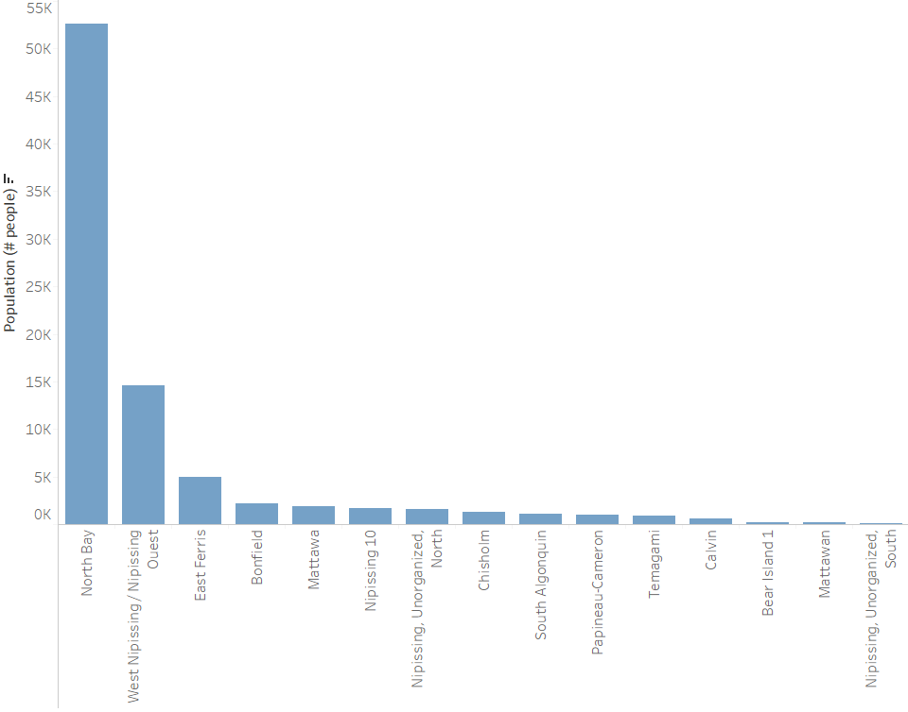
Nipissing District CSD Population 2021
62%
17%

Slide 18
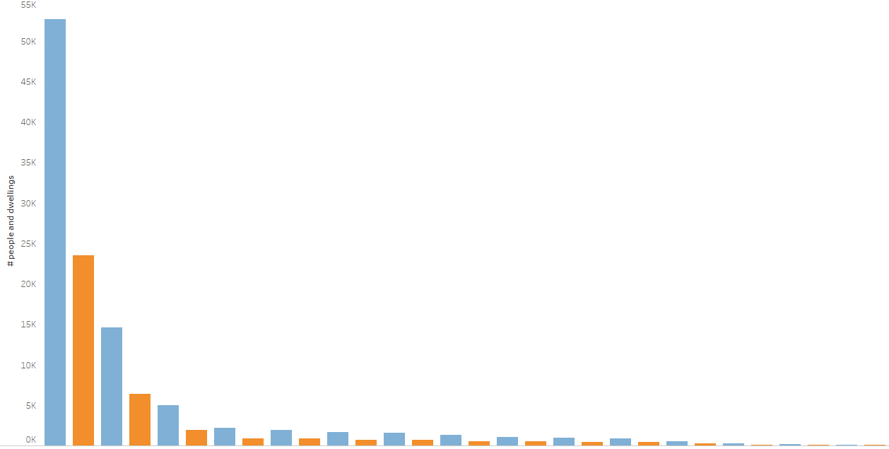
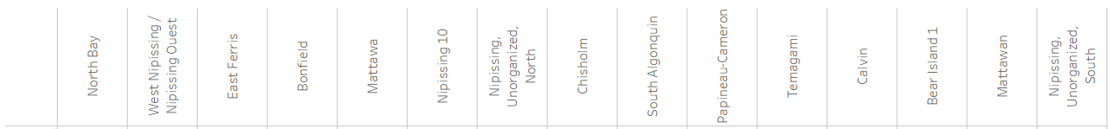
Nipissing District Population & Dwellings 2021
63%
17%

Slide 19
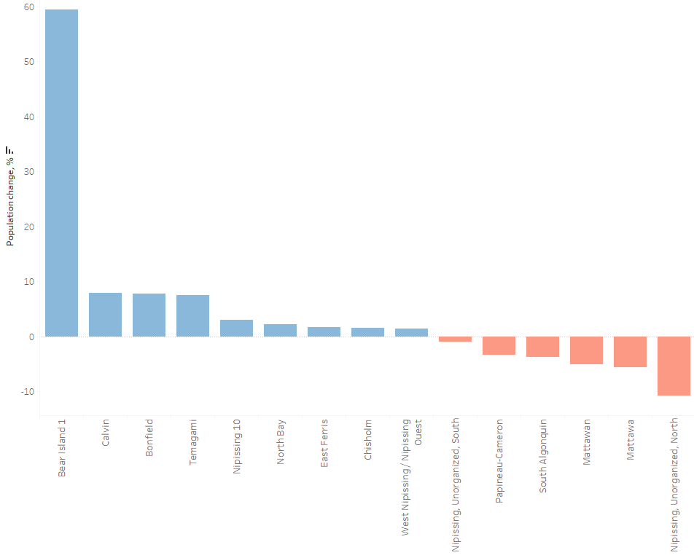
Nipissing Population Change: 2011 - 2016
7% range
1.5 - 3.0%
-1.0 - 6.0%

Slide 20
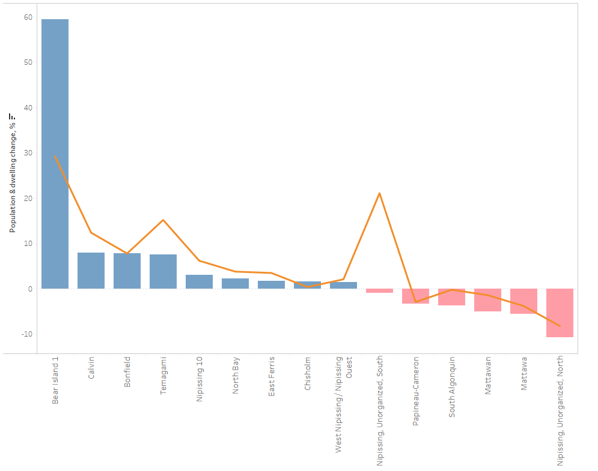
Nipissing Pop. & Dwell. Change 2016-2021
In most cases dwelling growth is outpacing population growth.
Or dwelling decline is lagging population decline.

Slide 21

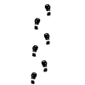
Thank you!

